Slide 1
University Success

Slide 2
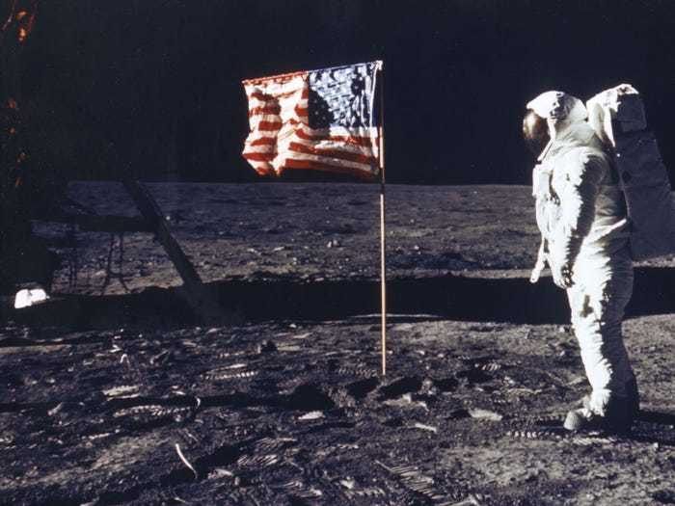
1
Flagging: gắn cờ, cắm cờ
/ˈflæɡ.ɪŋ/
The same: decreasing
He's trying to revive his flagging career.

Slide 3

2
Potent: mạnh mẽ, có hiệu lực, hiệu nghiệm
/ˈpəʊ.tənt/
The same: powerful and effective.
Surprise remains the terrorists' most potent weapon.

Slide 4
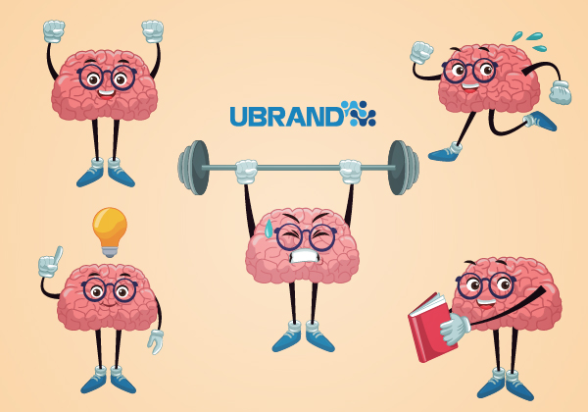
3
Reinforcement: sự củng cố, gia cố, sự trang bị
/riː.ɪnˈfɔːs.mənt/
The same: the act of making something stronger
The harbor walls need urgent reinforcement.

Slide 5

4
corporate activity : hoạt động công ty, hoạt động nhóm
/ˈkɔː.pər.ət ækˈtɪv.ə.ti/
The same: teamwork
Corporate activities help us to develop a lot more

Slide 6
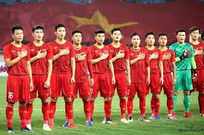
5
Anthem: quốc ca
/ˈæn.θəm/
The same: a formal or religious song
The national anthems of the teams are played at the beginning of international football matches.

Slide 7
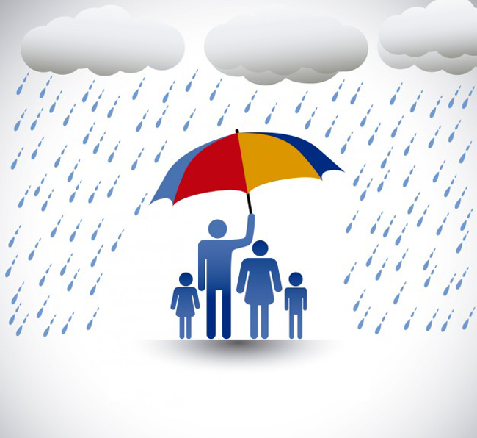
6
Safeguard: sự che chở, bảo vệ
/ˈseɪf.ɡɑːd/
The same: a rule or action that is intended to protect someone or something from possible dangers or problems
The union safeguards the interests of all its members.

Slide 8
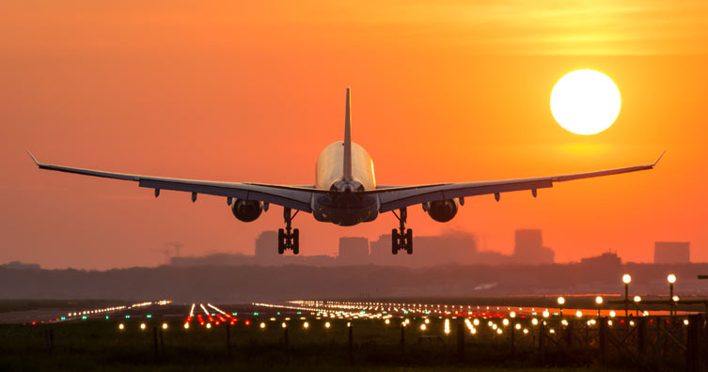
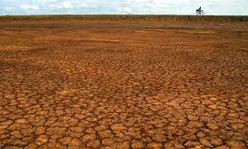
7
Land: đất liền, hạ cánh
/lænd/
The same: to come to rest after traveling through air or over water
It is cheaper to drill for oil on land than at sea.

Slide 9
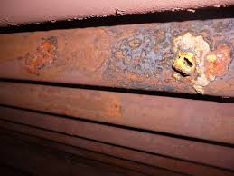
8
Sedimentation: sự đóng cặn, lắng đọng
/ˌsed.ɪ.menˈteɪ.ʃən/
The same: the formation of layers as material comes to rest on a surface
The process of sedimentation helps to explain the origin of fossils.

Slide 10

9
Sphere: lĩnh vực hoạt động
/sfɪər/
The same: an area of interest or a large group of people who share certain interests
Exchanges with other countries, particularly in cultural, scientific, and economic spheres.

Slide 11
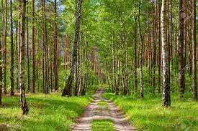
10
Avenues: đường mòn, đại lộ
/ˈæv.ə.njuː/
The same: pathway
We should explore/pursue every avenue in the search for an answer to this problem.

Slide 12
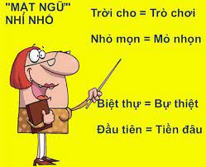
11
A play on: chơi chữ
The same: a clever or unusual use of words related to

Slide 13
12
Conclusion: sự kết luận, kết quả
/kənˈkluː.ʒən/
The same: one or two sentences indicating that the discussion of the paragraph's main idea is finished (most paragraph do not have conclusions)

Slide 14

13
Secular: thế tục
/ˈsek.jə.lər/
The same: related to worldly matters, not religious
We live in an increasingly secular society, in which religion has less and less influence on our daily lives.

Slide 15
14
of increasing less consequence: tăng ít hậu quả hơn
The same: less and less important

Slide 16
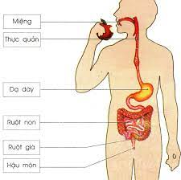
15
gastrointestinal tract: đường tiêu hóa
/ˌɡæs.trəʊˌɪn.tesˈtaɪ.nəl/
The same: the body system involving the stomach and intestines to digest food

Slide 17
16
Savvy: hiểu
/ˈsæv.i/
She's very intelligent, but hasn't got much savvy.

Slide 18
17
Endemic: bệnh địa phương, đặc trưng của vùng
/enˈdem.ɪk/
The same: present in a particular place among a particular group of people

Slide 19
18
a wide array of: một loạt các
The same: many types of

Slide 20
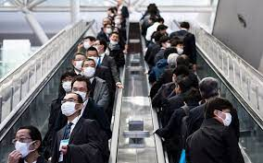
19
en masse: nhiều, gộp lại, toàn thể
/ˌɒ̃ ˈmæs/
The same: as a large group
The shop's 85 workers have resigned en masse.

Slide 21

20
Understatement: nói cách khác, nói giảm, nói nhẹ đi
/ˌʌn.dəˈsteɪt.mənt/
To say that her resignation was a shock would be an understatement - it caused panic.

